Slide 1
2.9 - Story
File created on: 2/19/2025 1:32:59 PM

Slide 2
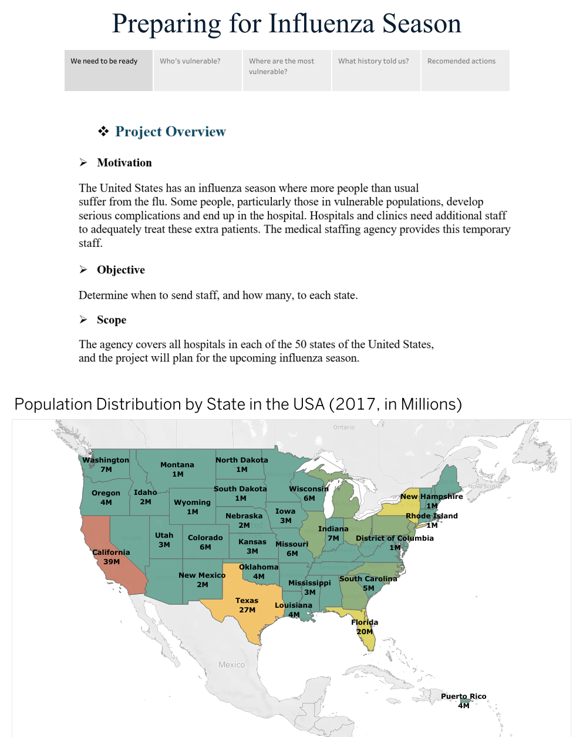

Slide 3
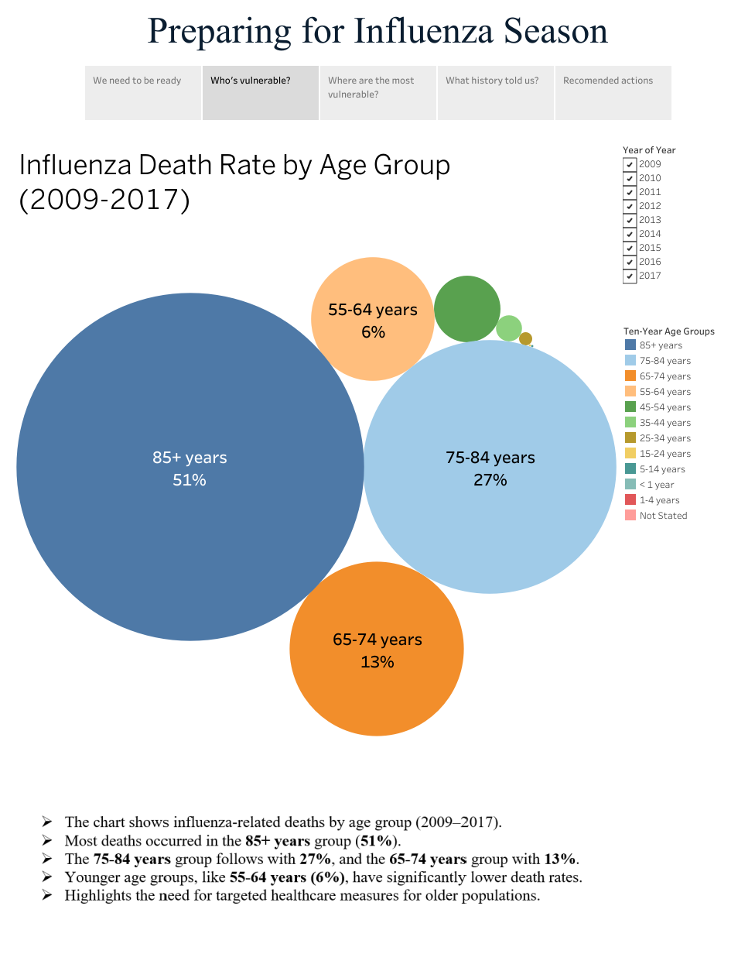

Slide 4
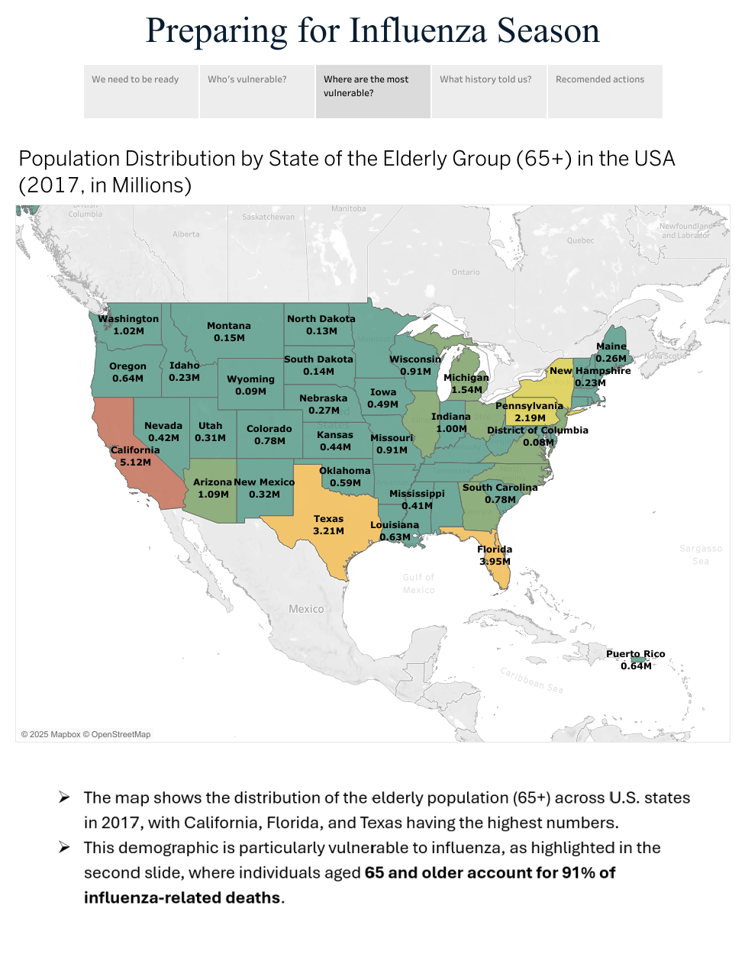

Slide 5
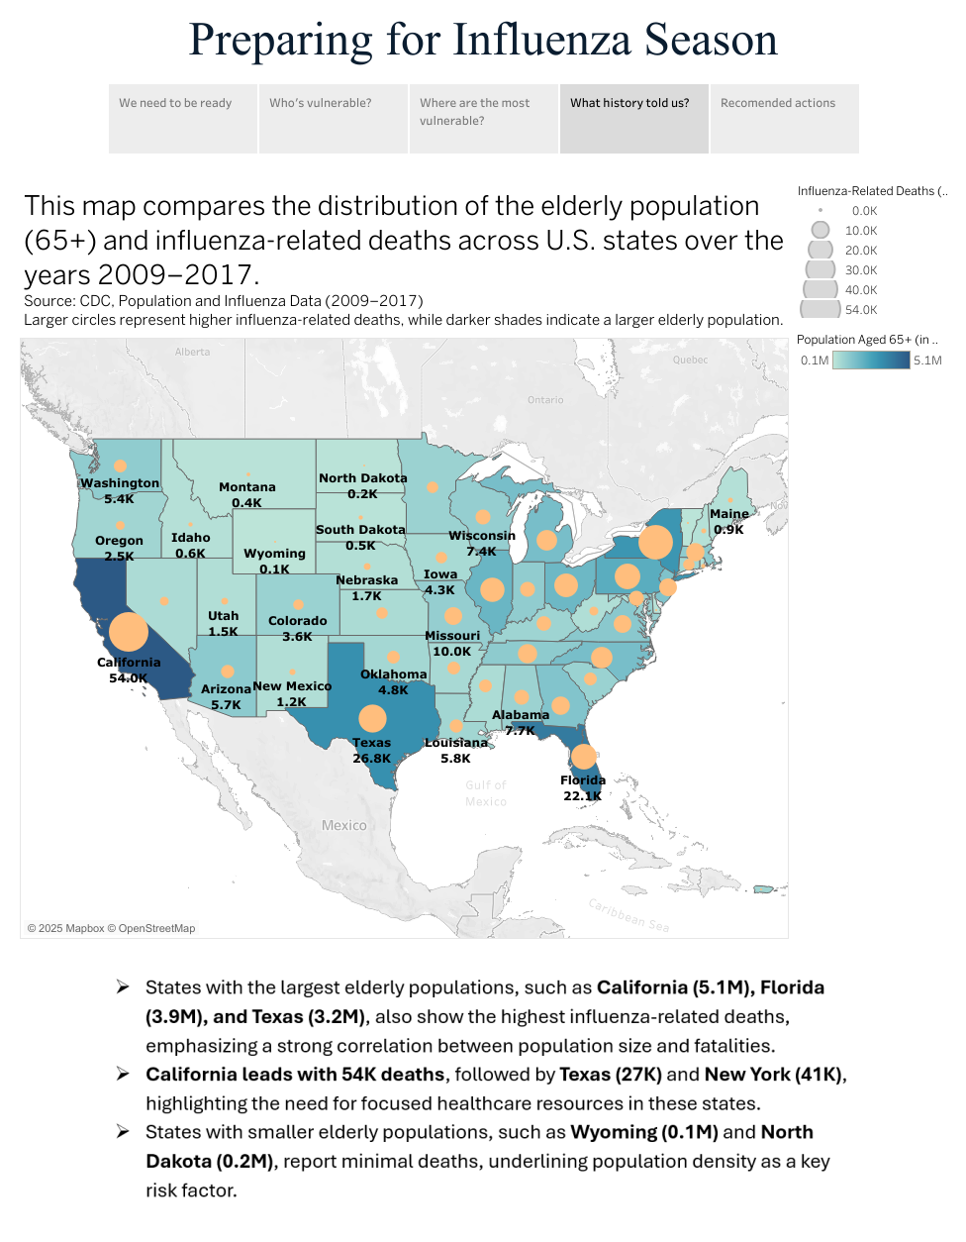

Slide 6
